Slide 1
Assignment 3

Slide 2
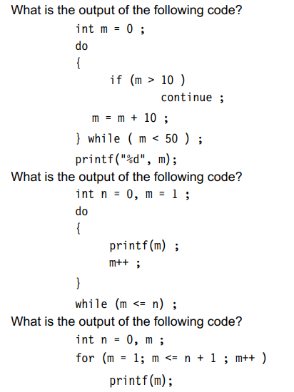

Slide 3
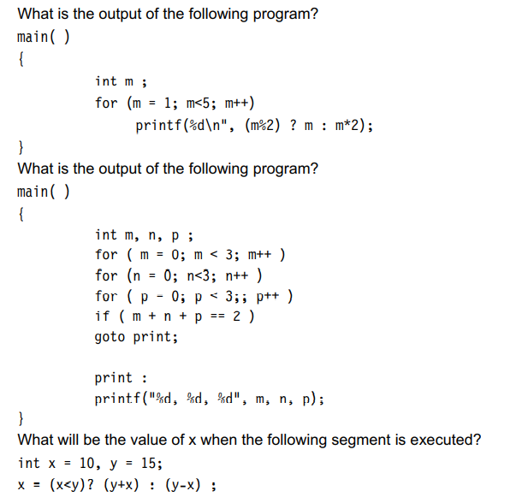

Slide 4
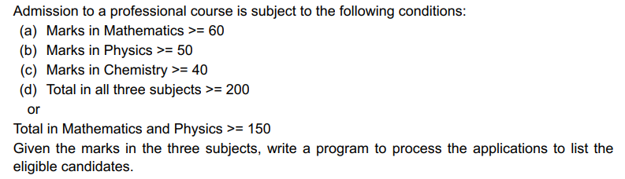
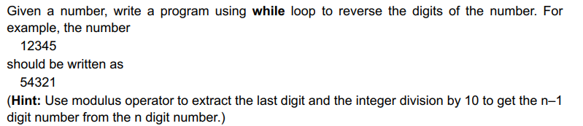
1
Write a program to find the number of and sum of all integers greater than 100 and less than 200 that are divisible by 7.
2
3

Slide 5
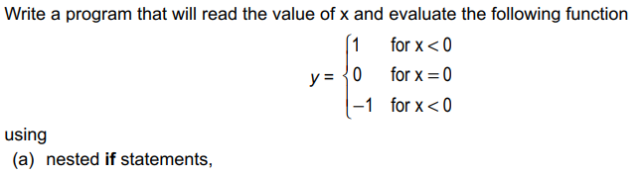

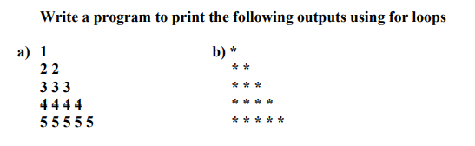
4
5
6
Write a program that will read a positive integer and determine and print its binary equivalent

Slide 6
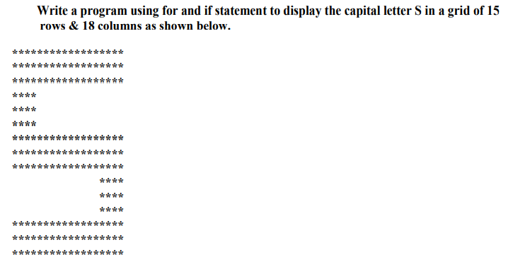
7
8

Slide 7
